Slide 1

Software System Architecture
PFS-VSP-006
PROJECT PRESENTATION
Event Ticket Booking System
High-concurrency microservices design, seat selection engine, dynamic queue management, and secure transactional workflow.
PRESENTER NAME
BATCH CODE
STUDENT ID
N. Dileep
pfs-vsp-006
CGVI0205

Slide 2

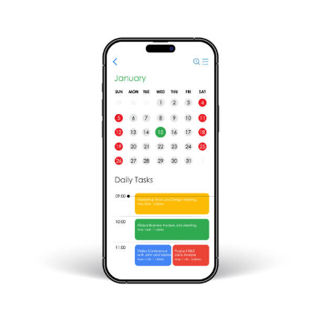
EXECUTIVE SUMMARY
System Overview & Domain Objectives
Real-Time Scalability
Handles thousands of simultaneous checkout attempts during flash sales without ticket overselling.
Interactive Seat Allocation
Interactive venue layouts displaying live seat availability states with microsecond synchronization.
Transactional Integrity
Guarantees atomic ACID transactions during ticket reservation, payment processing, and confirmation.

Slide 3




FUNCTIONAL REQUIREMENTS
Core Platform Capabilities
Event Discovery
Seat Selection
Payment Gateway
QR E-Ticketing
Filter events by location, date, category, and popularity with sub-second indexing.
Interactive venue layout mapping with temporary 10-minute hold lock during checkout.
Integrated webhooks supporting card processors, digital wallets, and auto-refunds.
Generates encrypted dynamic QR passes instantly delivered via Email and SMS.

Slide 4
SYSTEM ARCHITECTURE
Three-Tiered Scalable Architecture
Presentation Tier
React.js Web & Mobile Client
Responsive user interface rendering interactive seat maps, live booking timers, and user dashboards.
REST APIs & WebSockets
Application Tier
Node.js / Spring Boot Microservices
Manages event catalog, seat lock synchronization, payment webhooks, and QR ticket generation.
JDBC & In-Memory Redis Caching
Data Tier
MySQL (RDBMS) & Redis Cache
ACID compliant transaction log for finalized bookings backed by Redis in-memory locks for seat reservations.

Slide 5
TECHNICAL DEEP DIVE
Concurrency Handling & Double-Booking Prevention
Distributed Locking Workflow
1. Seat Request: User selects seat #42 in venue map.
2. Redis Mutex: System places a 10-minute key expiry lock.
3. State Broadcast: Seat shows 'Reserved' across all clients.
4. Checkout Timeout: Unpaid seats auto-release to waiting queue.
< 50ms
Lock Acquire Latency
100%
Overselling Prevention Guarantee

Slide 6
DATABASE SCHEMA
Core Data Schema & Entity Relationships
USERS
EVENTS
BOOKINGS
TICKETS
user_id (PK)
event_id (PK)
booking_id (PK)
ticket_id (PK)
full_name
title
user_id (FK)
booking_id (FK)
email_address
venue_id (FK)
total_amount
seat_number
hashed_password
total_seats
payment_status
qr_code_hash

Slide 7
QUALITY ATTRIBUTES
Non-Functional Requirements
Low Latency Search
High Availability
Catalog queries and filtering return results in under 200ms using Elasticsearch indexing.
99.99% uptime target maintained via auto-scaling server clusters and multi-region failover.
Payment Security
Horizontal Scalability
Full PCI-DSS compliance using TLS 1.3 encryption and tokenized payment gateway handshakes.
Stateless microservices designed for seamless container replication during flash traffic spikes.

Slide 8
IMPLEMENTATION OVERVIEW
Core Technology Stack
Layer | Technology Adopted | Architectural Purpose
Frontend UI | React.js / Tailwind CSS | Interactive component UI & seating layout visualization
Backend API | Node.js / Express / Spring Boot | RESTful endpoints, order queueing, & service logic
Database & Cache | MySQL & Redis Cache | Transactional records & microsecond seat locking key-store
Validation & Infra | Docker & Dynamic QR Engine | Encrypted ticket scanning and microservices containerization

Slide 9
CONCLUSION
Project Deliverables & Key Takeaways
Zero Overselling
Automated Entry
Production Ready
Redis locks effectively eliminate duplicate ticket allocations during high concurrency periods.
Dynamic QR validation streamlines physical venue access control and eliminates ticket fraud.
Layered microservice architecture guarantees horizontal expansion capacity as traffic scales.

Slide 10

Thank You
Questions & Answers | Event Ticket Booking System Architecture
Name: N. Dileep
|
Batch: pfs-vsp-006
|
ID: CGVI0205

Slide 11

Image Sources
https://media.istockphoto.com/id/2205014212/vector/smartphone-calendar-app-concept-to-do-list-tasks-ui-or-ux-design-mockup-mobile-planner.jpg?s=612x612&w=0&k=20&c=dvbOk6jflPeC-fsULH5gSNW2knJO1_oXOvi9gTnvtr8=
Source: www.istockphoto.com

